Slide 1

SPRINT 3 REVIEW
CQU LAB EQUIPMENT SOURCING

Slide 2
TEAM MEMBERS
S.NO | STUDENT NAME | STUDENT ID
01 | ADARSHA MANI LAMICHHANE | 12140071
02 | JAVAGAL SRINATH NARAYANAN | 12131213
03 | BANDANA KAPALI | 12127043
04 | MARUF SIDDIQUE | 12132167

Slide 3
SPRINT 3: WHAT WE DID.
Analyse the risk associated with the system.
Present the thorough risk analysis and management report.
Analyse the quality parameters of the system.
Present the quality management report.
Implementation of a User Story.
Provide a test demo for the user story implementation.

Slide 4

Quality Management Plan
The quality management plan is the necessary document required to manage the quality of the project effectively.
Quality management is the process of planning, scoping, implementing, and monitoring
of quality into all phases of the project from concept through the delivery aspects of the work (Patterson, 2019).
The project quality plan is prepared during the planning phase of the project.
Quality management involves planning, managing team, skill forming and other project planning things.
The intended audience are the project manager, project teams, senior leaders, and stakeholders.

Slide 5
IMPLEMENTATION OF USER STORY
User Story:
The system actors need to be able to access their own services assigned to them according to their role.
Implementation of the user story:
The system actors are divided mainly into Admins and Members.
A single login page appears at first when the system is started.
According to their individual login credentials, they are identified as admins or members of the system.
If the user is Admin of the Lab System, he is redirected to the admin dashboard where all the services assigned to an administrator is displayed and he will be able to access them all.
If the user is Member of the Lab System, he is redirected to the Member dashboard where all the services assigned to a member is displayed and he will be able to access them all.

Slide 6
TEST OF THE USER STORY IMPLEMENTATION
Test No. | Test Name | Input | Expected Output | Actual Output | Remarks
 | Login Portal Check (For Admin Login) | Username: admin Password: admin1 Login Button Clicked | Admin Dashboard needs to be displayed. | Admin Dashboard was displayed. | PASSED
2. | Login Portal Check (For Member Login) | Username: student Password: student1 Login Button Clicked | Member Dashboard needs to be displayed. | Member Dashboard was displayed. | PASSED

Slide 7
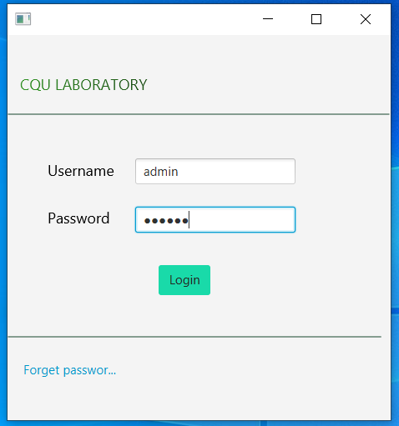
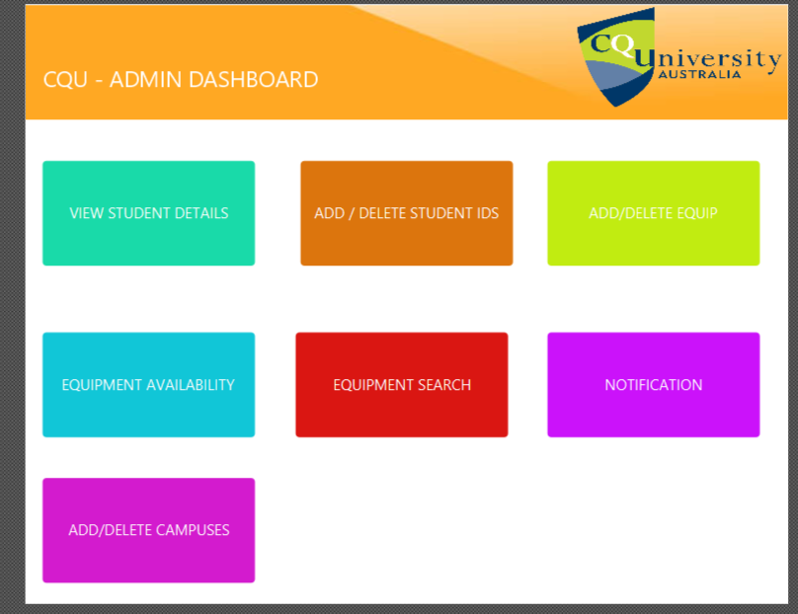
TEST EVIDENCES
Figure 2 Admin Dashboard displayed after Admin Logged In
Figure 1 Admin Logging in from Login Page

Slide 8
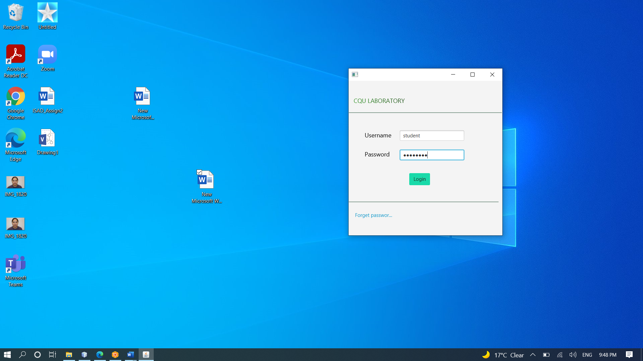
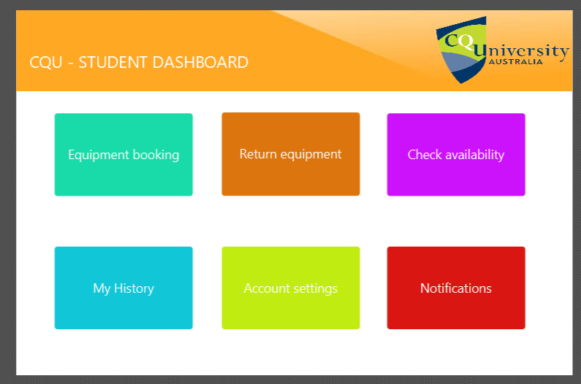
TEST EVIDENCES
Figure 4 Member Dashboard displayed after Member Logged In
Figure 3 Member Logging in from Login Page

Slide 9

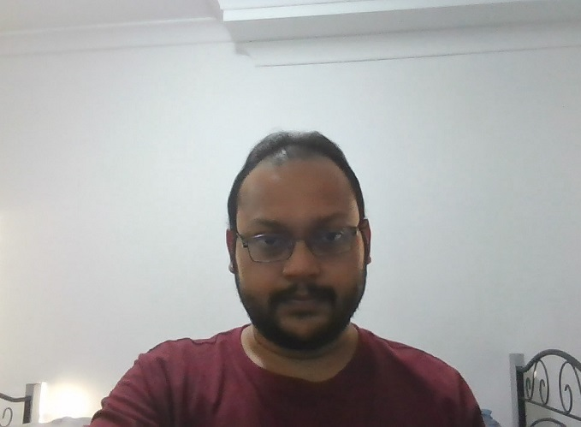
RISK MANAGEMENT PLAN - INTRODUCTION
What is risk and risk management?
Various risk may occur during the project development lifecycle; risk cannot be avoided but the impact of such risks can be vastly reduced with the help of project plan Therefore, the risk that may occur in the project are clearly identified with its occurrence and impact. Some of the risk that can occur in the discussed project are given below with their probability, impact on the project, threats caused by it on the project and mitigation strategy to reduce the impact of such risks.

Slide 10
RISK MANAGEMENT PLAN – INTRODUCTION
MITIGATE
If you can’t avoid the risk, you can mitigate it. This means taking some sort reduce the chances of negative impacts on your business.
AVOID
The best thing you can do of action that will cause it to do as little damage to your project as possible.
TRANSFER
One effective way to deal with a risk is to pay someone else to accept it for you. The most common way to do this is to buy insurance.
ACCEPT
When you can’t avoid, mitigate, or transfer a risk, then you must accept it. But even when you accept a risk, at least you’ve looked at the alternatives and you know what will happen if it occurs.

Slide 11
RISK MANAGEMENT PLAN IN THIS PROJECT
Requirement changes frequently by client side
Data Integration
Communication problem between team members
Task need to be spitted equally
Data tracking
Lack of Expertise
Upgrade platform
Team coordination
Inventory maintenance

Slide 12
S.NO | Risk | P | I | P*I | Solution / Mitigation
01 | Requirement changes frequently by client side | 6 | 7 | 42 | The project manager has to understand the initial stage of the document, Identify the queries. Have the meeting with the project owner frequently to get clear idea about their requirement before the initiation of work.
02 | Data Integration | 5 | 3 | 15 | In this project “Lab equipment sourcing” it is important to maintain the proper datasets. There are various tools to integrate the multiple datasets. By using those tools, it is easy to mitigate those risks.
03 | Communication problem between team members | 8 | 7 | 56 | It is the serious threat, where it may create serious impact to the project. It is mandatory to have internal discussion with their team members in daily basis. Updating their work in separate portal where every team member in the group can view their workings. It needs to be rectified at the initial stage itself.
04 | Task need to be spitted equally | 7 | 7 | 49 | First stage of reducing those risks by analysing the skillsets of each team member in the group. Based on their understandings and skillsets, tasks need to be listed and shared equally within their group.
05 | Data tracking | 6 | 5 | 30 | If the team members are updating their work in different DB, it creates difficulty in tracking those datasets. To overcome this issue, Centralized is the only option where helps to have access to all the other members in their group.

Slide 13
RISK MANAGEMENT PLAN - CONTD
06 | Lack of Expertise | 5 | 5 | 25 | If the user doesn’t have enough knowledge in handling the application, it may create the risks in multiple ways. To avoid this situation, The PM or other people who have involved in the project has to give KT (Knowledge Transfer) to the users of the application.
07 | Upgrade platform | 4 | 3 | 12 | The application needs to update frequently, it may help to reduce some risks. Currently, the application is running as standalone. But it could be better to have cloud-based application to increase the performance of the system.
08 | Team coordination | 6 | 7 | 42 | If there is any lang in team coordination, it will create the serious damage to the quality of the product. To overcome this issue, team building activities are helps to resolve those risks.
09 | Inventory maintenance | 5 | 4 | 20 | The equipment needs to be checked frequently; it has a chance of getting damaged. The quality of each equipment has to be checked and update at some interval of time.

Slide 14
SPRINT 3: SUMMARY
Developed a Quality Management Report to address all the parameters to Evaluate the quality of the system.
Analysed all the Risk associated with the system and produced a risk management Report.
Implemented a major user story to let the users login to the system into their corresponding dashboards according to their role.

Slide 15
SPRINT 4: PLANNING
Implementation of User Stories further.
Progress more on Development Phase.
Compile the documentation done till now and prepare for final documentation.
Finalize all the User Interfaces.
Interlink all the User Interfaces and complete the navigation of the system.
Start populating the database and integrate it to the system stepwise.
Update the PM tool and code repository.

